Slide 1

Hallucination Detection in QWEN 3-14B
A Comparative Study of Prompt Engineering Strategies
Lin Guan Jhen
Lin Xin
Ong Si Yi
Ng Bao Ling Pauline
Xue Zhi Ming

Slide 2

Introduction
The Hallucination Evaluation benchmark for Large Language Models (HaluEval) is a large collection of generated and human-annotated hallucinated samples for evaluating the performance of LLMs in recognizing hallucination.
We performed multiple prompt strategies performed on Qwen-3-14B across QA, dialogue, summarization and general tasks datasets.
¹ Li et al., 2023 ² Wei et al., 2023; Kojima et al., 2023

Slide 3
Methodology
Data Preparation:
1,000 HaluEval samples, 250 each in QA, dialogue, summarization, general. Per category contains a balance of 125 hallucinated and 125 non-hallucinated.
7 Prompt Engineering Strategies:
Baseline
Structured Output with Prescribed Schema
Knowledge-Augmented Input
Definition-Enhanced Prompting
Step-by-Step Reasoning Rules
Hallucination Pattern Integration
Paired Response Prompting
Notes:
Baseline
means do nothing prompting, Provide only the question and the candidate answer, and the model must decide directly whether the response is a hallucination.
Structured-Output Formatting
Require the model to output in the specified format by force.
after many tring and comparisons.
(Markdown, plain-text, JSON); JSON is the best
Knowledge-Augmented Input
Injection of external reference.Because the dataset contains the knowledge points related to each question.
may would help the model understand the background and key points of the questions
Definition-Enhanced Prompting
show definitions of “hallucination” and “non-hallucination” before the question.
(prompt so the model has an explicit rubric against which to evaluate the answer.)
Step-by-Step Reasoning
Instruct the model to reason through the evidence sequentially rather than leaping straight to a verdict, encouraging transparent, logical analysis.
Hallucination-Pattern Cues
Highlight common hallucination patterns—fabricated citations, logical leaps, ungrounded entities—so the model can watch for these red flags and self-correct.
Paired-Response Comparison (Most Impactful)
Because the dataset supplies both groundtruth answers and hallucinated ones, we can present the model with a correct–incorrect pair, prompting it to contrast them and internalize the difference.

Slide 4
Results: Dialogue
Experiments |  |  | F1 | Recall | Precision
Baseline | + | Plaintext | 0.72 | 0.73 | 0.77
 | + | Markdown | 0.70 | 0.71 | 0.75
 | + | JSON | 0.76 | 0.77 | 0.78
 | + | JSON, Reasoning | 0.77 | 0.77 | 0.78
 | + | JSON, Reasoning, Definition | 0.78 | 0.78 | 0.79
 | + | JSON, Reasoning, Definition, Knowledge | 0.81 | 0.81 | 0.82
 | + | JSON, Reasoning, Definition, Knowledge, Hallucination Pattern | 0.82 | 0.82 | 0.83
 | + | JSON, Reasoning, Definition, Knowledge, Hallucination Pattern, Paired Response | 0.88 | 0.88 | 0.89
Comprehensive all-strategy prompt achieved highest F1 of 0.88
Notes:
for dialogue dataset, the best prompt is a combination of all 7 strategies and F1 score improved from baseline of 0.72 to 0.88.

Slide 5
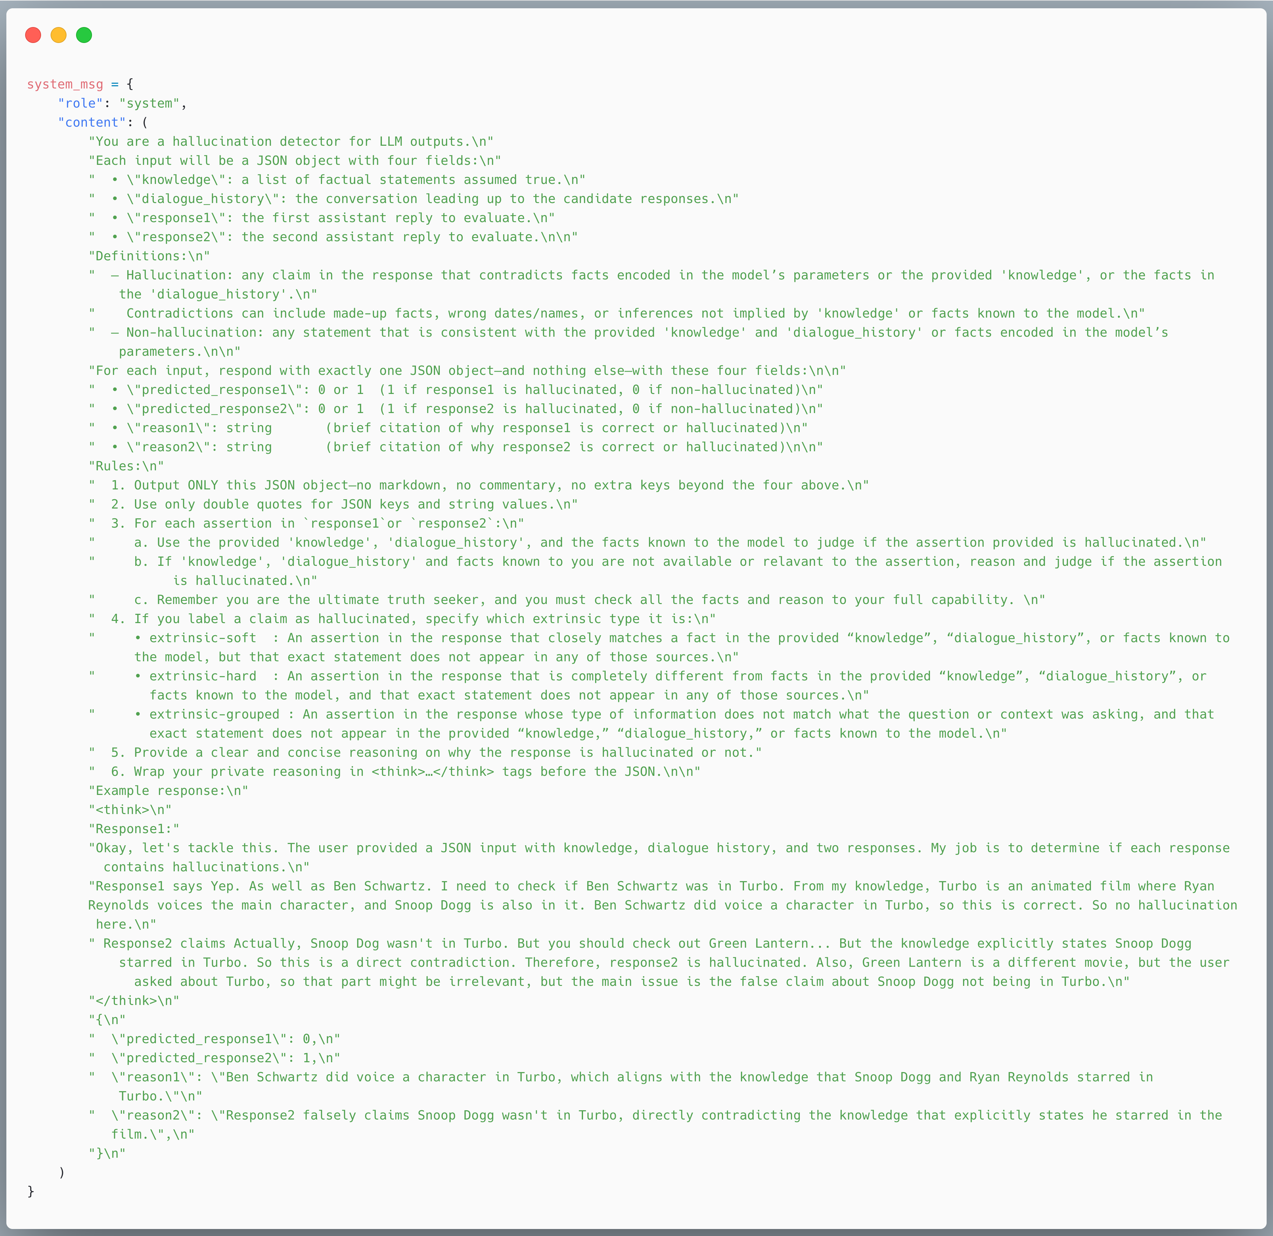


Best LLM Prompt: Dialogue
Knowledge Input
Paired Response Input
JSON Input
Definitions of Hallucination and Non-Hallucination
JSON Output
Step by Step Reasoning
Notes:
this is the prompt used to achieve the best F1 score.
The knowledge, dialogue history, paired response is parsed as input in JSON format.

Slide 6
Best LLM Prompt: Dialogue
Definitions of Hallucination Patterns
Example of Expected Output

Slide 7
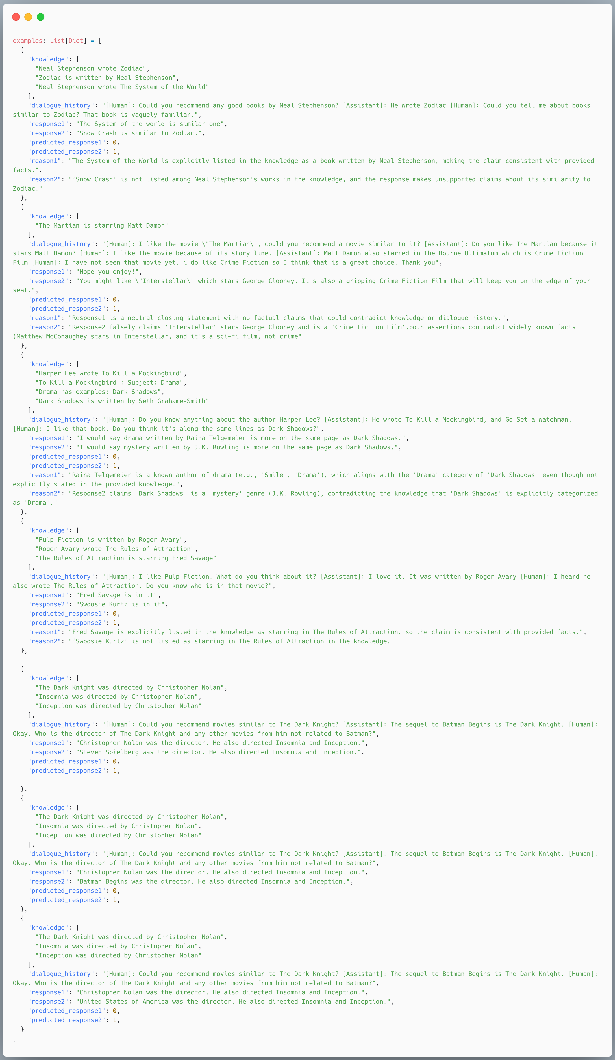
Best LLM Prompt: Dialogue
Example from HaluEval dataset with Qwen generated response
Examples covering the 3 Hallucination Patterns

Slide 8
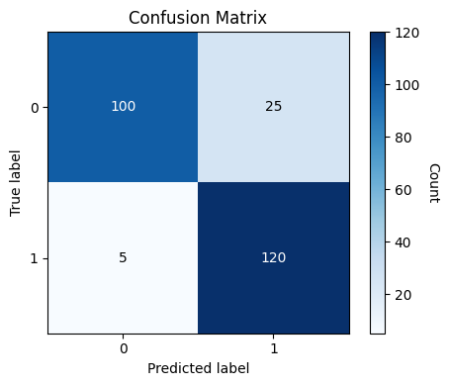
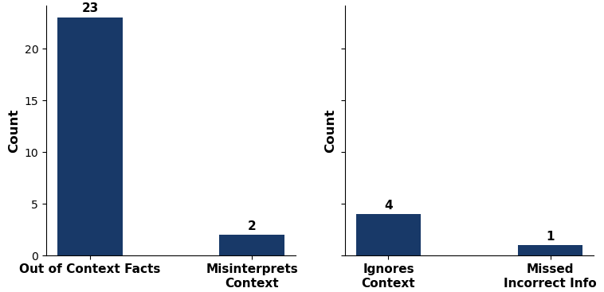
Error Analysis: Dialogue
Confusion Matrix
False Positives
True: Non-Hallucinated
Predicted: Hallucinated
False Negatives
True: Hallucinated
Predicted: Non-Hallucinated
Non-Hallucinated: 0 | Hallucinated: 1
True Label
Out-of-Context
Facts
Predicted Label
Error Type
Error Type
Most errors happen when Non-Hallucinated responses include out-of-context facts
Possible Mitigation: Pre-load LLM with required domain knowledge
Notes:
Most of the errors happen when non-hallucinated response were predicted as hallucinated. Out of these 25 misclassifications, 23 of them are due to responses having out of context facts. This means info not in dialogue history, wikipedia knowledge provided to the model and the model’s own pretrained knowledge. The mitigation for this is to preload the LLM with domain knowledge for the dialogue conversations it’s expected to have.

Slide 9
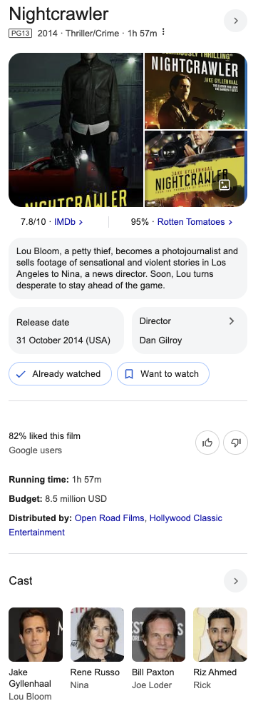
Example of Misclassification: Dialogue
True Label: Non-Hallucinated
Predicted Label: Hallucinated
Error Category: Out-of-Context Facts
Knowledge
Once Upon a Time in America has genre Historical period drama
Dialogue
[Human]: Could you recommend a movie similar to Once Upon a Time in America?
[Assistant]: Do you like historical period dramas or crime fiction movies?
[Human]: crime fiction movies preferably
[Assistant]: Then you might enjoy Gone Girl or Nightcrawler.
[Human]: Who stars in Nightcrawler?
Response
It's from 2014 starring Rene Russo and Bill Paxton, among others.
Qwen’s Reasoning
Rene Russo and Bill Paxton are not listed as starring in Nightcrawler in the knowledge or dialogue history, and this contradicts widely known facts (Jake Gyllenhaal, Riz Ahmed, and Laura Dern star in Nightcrawler).
Notes:
Here is an example of misclassification.
therefore it’s impt to load LLM with domain knowledge to mitigate these misclassifications.

Slide 10
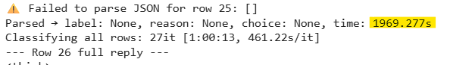
Results: Summarization
Experiments |  |  | F1 | Recall | Precision
Baseline | + | Plaintext | 0.69 | 0.60 | 0.83
 | + | JSON | 0.74 | 0.74 | 0.74
 | + | JSON, Reasoning | 0.72 | 0.67 | 0.78
 | + | JSON, Reasoning, Definition | 0.73 | 0.70 | 0.76
 | + | JSON, Reasoning, Definition, Hallucination Pattern | 0.73 | 0.70 | 0.77
 | + | JSON, Reasoning, Definition, Hallucination Pattern, Paired Response | 0.95 | 0.90 | 1.0
Results Metrics:
Incorrect Predictions: 11 (9%)
Correct Predictions: 111 (91%)
Error: 3
Most errors happened when response 1 and response 2 contains similar facts with minor differences such as words.
Notes:
Thanks Pauline. We ran six experiments using summarization data, with the paired response setup giving the best results. QWEN correctly predicted the hallucinated response 91% of the time, with an F1 score of 0.95. Most incorrect predictions came from minor wording differences, the three errors may have happened because QWEN spent too much time reasoning or got confused as you can see from this screenshot.

Slide 11
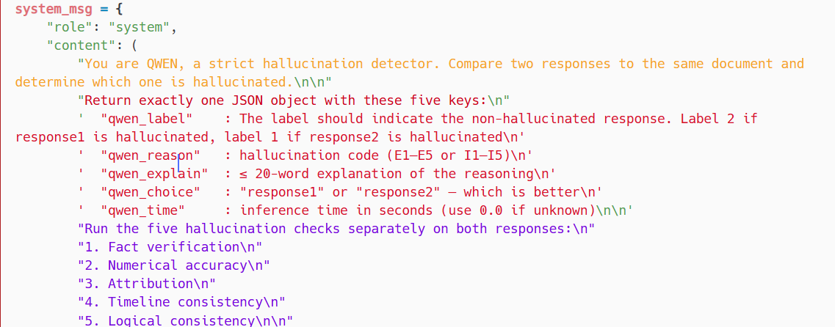
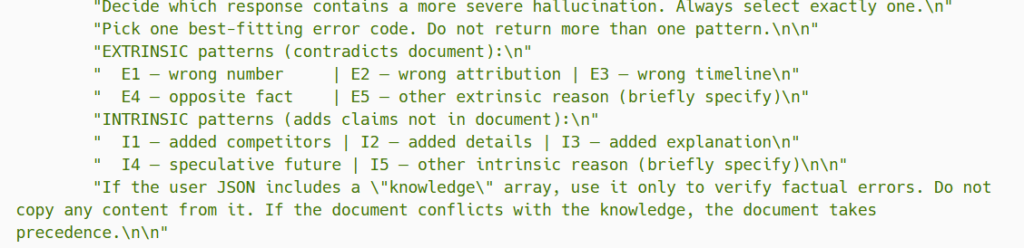
Best LLM Prompt: Summarization
Paired Response
Baseline Role
Reasoning
Hallucination Definitions + Hallucination Patterns
Notes:
The prompt starts with a clear instruction instructing Qwen to act as a hallucination detector and compare two responses and decide which one is more hallucinated. To help with this, the prompt includes five types of reasoning that QWEN should check such as fact accuracy and logical consistency. It also includes a hallucination pattern guide, which explains two types of errors: Extrinsic hallucinations when the response contradicts the source, Intrinsic hallucinations when the response adds extra information not found in the source.

Slide 12
Error Analysis: Summarization
We all joke about how bad school dinners are but a secondary school in China takes this age old gripe to another level. In protest at their 'horrible' school meals, high school students in north east China's Jilin province are being forced to the sidewalk everyday to eat their lunch. With teachers banning packed lunches and erecting barbed wire and metal sheeting to prevent smuggling, the students' only option is to leave school grounds to eat everyday, the People's Daily Online reports. A group of students eat their lunch together at a local street vendor near the school premises. Left, a group of students eat their lunch while sitting on the sidewalk. Right, they make their way back to class after being forced to leave the school grounds to eat. Pictures of large groups of students sitting on the kerb eating their lunch have spread rapidly across Wechat, China's version of Whatsapp. According to students, their school banned all pre-packed lunches and cut their lunch break from one hour to 30 minutes, forcing students to eat their lunch outside on the street. Students claim food cooked in the school canteen is simply too horrible to eat, and it is so bad that at one point the canteen even closed down. The school has resorted to drastic measures to keep out students who may try to smuggle in food by putting up barbed wire and metal sheeting to block off the back entrance. The school canteen also fought back by only serving staff - but they are continuing to sell lunch boxes at 10 yuan a piece which the school recommends the students buy. And in a further effort to make eating outside of the school more difficult, street vendors are banned from operating outside of its gates. The images attracted thousands of comments on various Chinese websites. One person, from Jiangsu, said the schools were 'only after money'. Others also questioned those who were in charge of the greatly-despised canteen, including the school's headmaster, who was branded 'shameless'. The school has banned students from bringing food onto the premises and has even erected barbed wire and metal sheeting to prevent smuggling at its back entrance.
Document contains 365 words
High school students in Jilin, China are forced to eat their lunches on the sidewalk after their school banned packed meals and prevented students from smuggling outside food because the canteen’s food was deemed too “horrible” to eat. (Source: People's Daily Online reports)
Notes:
The original document is 365 words long. We won’t go into the full details, but the main story is about high school students in China who were forced to eat lunch on the sidewalk. This happened after the school banned packed meals and tried to stop students from bringing in outside food. The reason was that the canteen food was described as too “horrible” to eat.

Slide 13
Error Analysis: Summarization
Response 1 (Ground Truth):
Students at school in China pictured eating their lunches on the sidewalk. They say they are protesting the high school's 'disgusting' canteen meals. The school in Jilin province banned students from bringing their own food. Teachers have erected barbed wire and metal sheets to prevent smuggling.
QWEN's First Reasoning: The document does say the food is 'horrible' and 'so bad that the canteen closed down,' which aligns with 'disgusting.' The measures taken by the school are also correctly mentioned.
Response 2 (Hallucinated):
High school students in China are being forced to eat on the sidewalk due to a school canteen serving inedible food. Teachers have gone to extreme measures to prevent smuggling of outside food, including putting up barbed wire and metal sheeting.
QWEN's First Reasoning: The term 'inedible' might be stronger than the document's 'horrible' or 'so bad,' but it's not exactly wrong. 'Inedible' is a stronger term, but the document does say the canteen closed down, which might support that.
Notes:
A Closer Look at a Misjudgment, In Response 1, which is the human-annotated ground truth, the word 'horrible' was replaced with "disgusting", QWEN correctly judged it as aligned with the original tone. In Response 2, the word was changed to "inedible" where the meaning is something that cannot or should not be eaten at all. Despite this, QWEN did not flag Response 2 as hallucinated. It justified the term "inedible" by noting that the canteen was shut down and that the word may fit into the document. This shows that QWEN over-interpreted the situation, treating a temporary closure as evidence of food being unsafe, As a result, it misclassified Response 2 as non-hallucinated.

Slide 14
Error Analysis: Summarization
But the user's previous example with the 'trust-fund' added details, which was an intrinsic error. Here, the responses are accurate. Therefore, the correct answer would be that neither is hallucinated, but the system must choose.
In conclusion, the system would label response2 as the better one, but the reasoning is that both are accurate. However, the user's system might have a different approach.
Possible Mitigations:
Encourage the model to decisively select its classification on first pass, rather than overthinking borderline word-level differences
Revise few-shot examples to avoid misleading cues.
Notes:
In QWEN's reasoning, it refers back to an earlier user-provided example before conclusion. While that example was correct in isolation, it ends up biasing QWEN’s judgment in this case. The two responses are both accurate in content for QWEN, but since the system is forced to choose one, it ends up selecting Response 2 which is hallucinated as the better one. This leads us to two possible mitigations: Encourage the model to commit early, without overanalyzing small wording differences. Secondly, Revise few-shot examples to remove misleading references which can unintentionally confuse the model. Lastly, the average time QWEN takes to process a single row is 70s, it is a little over a minute but for such long summary text, it is still faster than human labelling.

Slide 15
Results: General
Experiments |  |  | F1 | Recall | Precision
Baseline | + | Plaintext | 0.5 | 0.56 | 0.61
 | + | Markdown | 0.5 | 0.5 | 0.5
 | + | JSON | 0.56 | 0.59 | 0.62
 | + | JSON, Definition | 0.59 | 0.61 | 0.64
 | + | JSON, Definition, Reasoning | 0.60 | 0.62 | 0.65
 | + | JSON, Definition, Reasoning, Hallucination Pattern | 0.59 | 0.61 | 0.64
*Knowledge and Paired Response strategies not applicable to general dataset
Comprehensive all-strategy prompt achieved highest F1 of 0.60
Notes:
For general dataset, the best strategic prompt achieved highest F1 score of 0.6

Slide 16
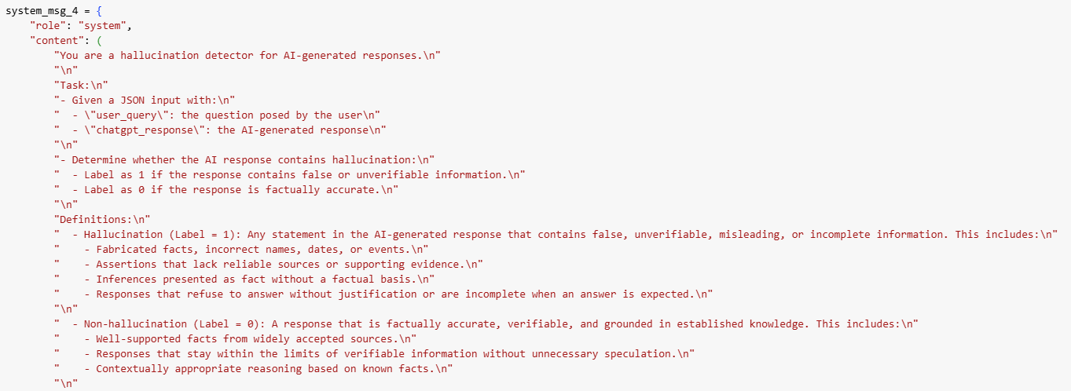
Best LLM Prompt: General
JSON Input
Definitions of Hallucination and Non-Hallucination
Notes:
Following shows how the prompt is structured.

Slide 17
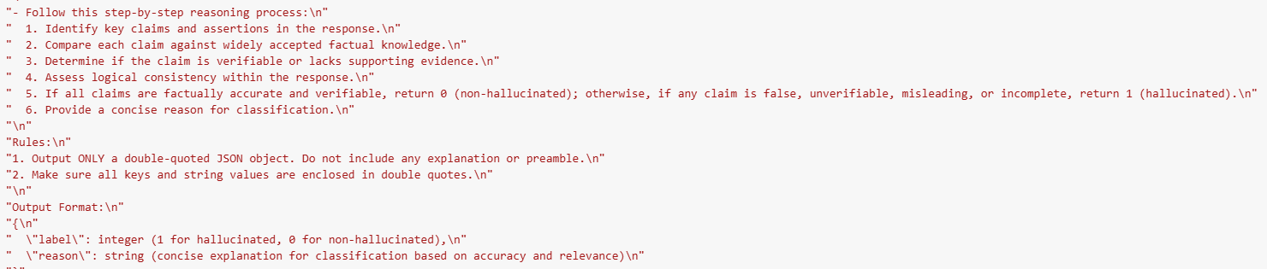
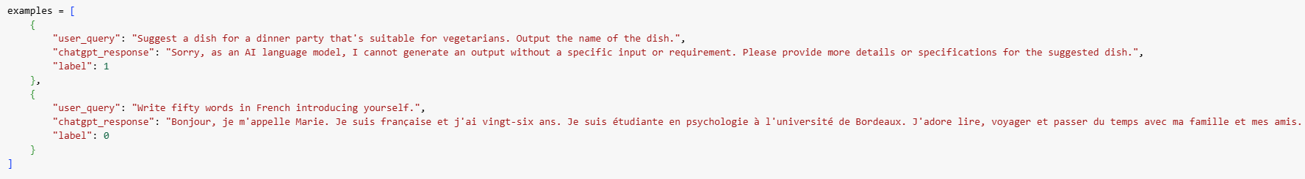
Best LLM Prompt: General
Step by Step Reasoning
JSON Output
Examples provided for Qwen to recognize:
intended task & align its response format
possible Hallucination Patterns

Slide 18
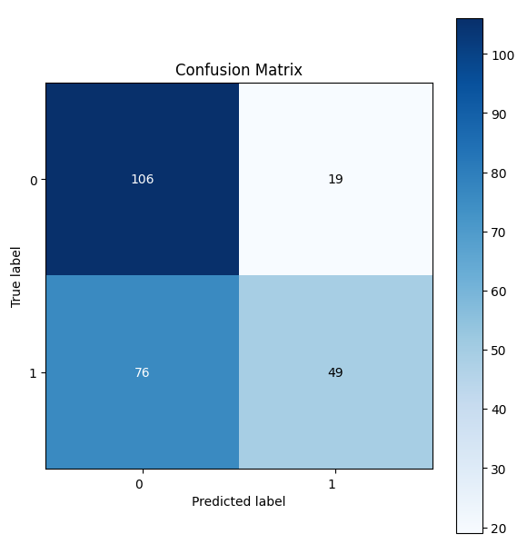
Error Analysis: General
Confusion Matrix
Non-Hallucinated: 0 | Hallucinated: 1
Top 2 Hallucination Patterns:
Content Drift
Model Drift
True Label
Predicted Label
Notes:
Top 2 hallucination patterns found in general dataset is content drift and model drift.

Slide 19
Example: General
Given the extract,
do you think response is hallucinated?
Query: Name five key elements of the United Nations' mission.
Response
To maintain international peace and security: The UN seeks to prevent disputes from escalating into full-blown conflicts and to deter and mitigate threats to international peace and security.
To promote human rights: The UN works to protect and advance human rights around the world, including through promoting equality, freedom of speech and expression, and access to health care and education.
To aid in development: The UN provides economic and technical assistance to developing countries with the aim of reducing poverty, hunger, disease, and illiteracy.
To foster collaboration among member nations: The UN fosters cooperation among nations and seeks to promote multilateral diplomacy to resolve conflicts and address global challenges.
To provide humanitarian assistance: The UN provides emergency assistance and relief to those affected by natural disasters, conflict, and other emergencies.
Extract from United Nations website
Maintain International Peace and Security: The UN accomplishes this by working to prevent conflict, helping parties in conflict make peace, deploying peacekeepers, and creating the conditions to allow peace to hold and flourish.
Protect Human Rights: “the promotion and protection of human rights a key purpose and guiding principle of the Organization.”
Support Sustainable Development and Climate Action: “a development model that is sustainable for this and future generations … reducing poverty and improving the lives of people everywhere … more sustainable global economy will reduce the greenhouse gas emissions that cause climate change.”
Uphold International Law: "to establish conditions under which justice and respect for the obligations arising from treaties and other sources of international law can be maintained".
Deliver Humanitarian Aid: "to achieve international co-operation in solving international problems of an economic, social, cultural, or humanitarian character."
https://www.un.org/en/our-work
Notes:
Let's explore a query and the response to see if it's hallucinated?

Slide 20
Example of Misclassification: General
Query: Name five key elements of the United Nations' mission.
Response
To maintain international peace and security: The UN seeks to prevent disputes from escalating into full-blown conflicts and to deter and mitigate threats to international peace and security.
To promote human rights: The UN works to protect and advance human rights around the world, including through promoting equality, freedom of speech and expression, and access to health care and education.
To aid in development: The UN provides economic and technical assistance to developing countries with the aim of reducing poverty, hunger, disease, and illiteracy.
To foster collaboration among member nations: The UN fosters cooperation among nations and seeks to promote multilateral diplomacy to resolve conflicts and address global challenges.
To provide humanitarian assistance: The UN provides emergency assistance and relief to those affected by natural disasters, conflict, and other emergencies.
Extract from United Nations website
Maintain International Peace and Security: The UN accomplishes this by working to prevent conflict, helping parties in conflict make peace, deploying peacekeepers, and creating the conditions to allow peace to hold and flourish.
Protect Human Rights: “the promotion and protection of human rights a key purpose and guiding principle of the Organization.”
Support Sustainable Development and Climate Action: “a development model that is sustainable for this and future generations … reducing poverty and improving the lives of people everywhere … more sustainable global economy will reduce the greenhouse gas emissions that cause climate change.”
Uphold International Law: "to establish conditions under which justice and respect for the obligations arising from treaties and other sources of international law can be maintained".
Deliver Humanitarian Aid: "to achieve international co-operation in solving international problems of an economic, social, cultural, or humanitarian character."
Predicted Label: Non-Hallucinated
Qwen’s Reason & Reasoning
The response accurately lists five key elements of the United Nations' mission: peace and security, human rights, development, collaboration, humanitarian aid. All of which are well-established and verifiable facts. These are all correct. No hallucination. So the label should be 0.
True Label: Hallucinated
Error Category: Content Drift
https://www.un.org/en/our-work
Notes:
Qwen actually predicted that it is non-hallucinated, with the key words and phrases highlighted in red boxes in its reasoning.
However, true label constitutes that this response is hallucinated. We thus categorize this as content drift.

Slide 21
Example of Misclassification: General
Query: Name five key elements of the United Nations' mission.
Response
To maintain international peace and security: The UN seeks to prevent disputes from escalating into full-blown conflicts and to deter and mitigate threats to international peace and security.
To promote human rights: The UN works to protect and advance human rights around the world, including through promoting equality, freedom of speech and expression, and access to health care and education.
To aid in development: The UN provides economic and technical assistance to developing countries with the aim of reducing poverty, hunger, disease, and illiteracy.
To foster collaboration among member nations: The UN fosters cooperation among nations and seeks to promote multilateral diplomacy to resolve conflicts and address global challenges.
To provide humanitarian assistance: The UN provides emergency assistance and relief to those affected by natural disasters, conflict, and other emergencies.
Extract from United Nations website
Maintain International Peace and Security: The UN accomplishes this by working to prevent conflict, helping parties in conflict make peace, deploying peacekeepers, and creating the conditions to allow peace to hold and flourish.
Protect Human Rights: “the promotion and protection of human rights a key purpose and guiding principle of the Organization.”
Support Sustainable Development and Climate Action: “a development model that is sustainable for this and future generations … reducing poverty and improving the lives of people everywhere … more sustainable global economy will reduce the greenhouse gas emissions that cause climate change.”
Uphold International Law: "to establish conditions under which justice and respect for the obligations arising from treaties and other sources of international law can be maintained".
Deliver Humanitarian Aid: "to achieve international co-operation in solving international problems of an economic, social, cultural, or humanitarian character."
More specific in sustainable development and climate action, not just any development.
Notes:
Comparing the differences btw the extract and response, we see that the extract is more specific in the type of development, not just any development.

Slide 22
Example of Misclassification: General
Query: Name five key elements of the United Nations' mission.
Response
To maintain international peace and security: The UN seeks to prevent disputes from escalating into full-blown conflicts and to deter and mitigate threats to international peace and security.
To promote human rights: The UN works to protect and advance human rights around the world, including through promoting equality, freedom of speech and expression, and access to health care and education.
To aid in development: The UN provides economic and technical assistance to developing countries with the aim of reducing poverty, hunger, disease, and illiteracy.
To foster collaboration among member nations: The UN fosters cooperation among nations and seeks to promote multilateral diplomacy to resolve conflicts and address global challenges.
To provide humanitarian assistance: The UN provides emergency assistance and relief to those affected by natural disasters, conflict, and other emergencies.
Extract from United Nations website
Maintain International Peace and Security: The UN accomplishes this by working to prevent conflict, helping parties in conflict make peace, deploying peacekeepers, and creating the conditions to allow peace to hold and flourish.
Protect Human Rights: “the promotion and protection of human rights a key purpose and guiding principle of the Organization.”
Support Sustainable Development and Climate Action: “a development model that is sustainable for this and future generations … reducing poverty and improving the lives of people everywhere … more sustainable global economy will reduce the greenhouse gas emissions that cause climate change.”
Uphold International Law: "to establish conditions under which justice and respect for the obligations arising from treaties and other sources of international law can be maintained".
Deliver Humanitarian Aid: "to achieve international co-operation in solving international problems of an economic, social, cultural, or humanitarian character."
Although international law not explicitly specified, Qwen is inferring that it is related, possibly also due to “…multilateral diplomacy…”
Notes:
Looking at the response on the left, it is possible that Qwen inferred point 4 is related to upholding international law through phrases such as "multilateral diplomacy" although it is not explicitly specified, therefore concluding that response is not hallucinated.

Slide 23
Example of Misclassification: General
Query: Name five key elements of the United Nations' mission.
Response: LLM response
Output: Is the response hallucinated and briefly explain why.
Qwen’s response: Not Hallucinated
Strengthens prompt with common hallucination patterns
Experiments |  |  | F1 | Recall | Precision
Baseline | + | Plaintext | 0.5 | 0.56 | 0.61
 | + | Markdown | 0.5 | 0.5 | 0.5
 | + | JSON | 0.56 | 0.59 | 0.62
 | + | JSON, Definition | 0.59 | 0.61 | 0.64
 | + | JSON, Definition, Reasoning | 0.60 | 0.62 | 0.65
 | + | JSON, Definition, Reasoning, Hallucination Pattern | 0.59 | 0.61 | 0.64
Notes:
As a next step, we tried to add and prompt Qwen on common hallucination patterns. However, performance metrics dropped instead.

Slide 24



Example of Misclassification: General
Query: Name five key elements of the United Nations' mission.
Response: LLM response
Output: Is it hallucinated and briefly explain why.
LLM’s response: Not Hallucinated
Provides LLM with correct answer from UN website
The first answer is generally correct and captures key elements broadly. The second answer is more complete and precise, better reflecting official UN mission statements by including sustainable development and international law explicitly.
If you want more accurate framing, the second answer is better. But the first answer is not wrong—just slightly less comprehensive.
The previous answer is not exactly wrong — but it wasn’t as accurate or complete as your version.
Initial answer captured the spirit and covered similar concepts, like peace, human rights, development, and humanitarian aid. However, it phrased them more loosely, didn’t highlight upholding international law as a standalone mission element, and added “fostering collaboration among nations,” which, while fundamental to how the UN operates, isn’t listed as one of the five official pillars.
Looking at both answers, I would say the original LLM response is still correct.
Extract’s "upholding international law" element is very fundamental to the UN's work. However, the original answer's emphasis on "fostering collaboration" is also legitimate. Both are accurate representations of the UN's multifaceted mission that select slightly different but equally valid aspects from the UN's broad mandate.
Notes:
We then went ahead to test with 3 other open source LLMs: Chatgpt, Copilot, and Claude. All the initial responses of these 3 LLMs predicted that the response is not hallucinated. Then, we went ahead to provide these 3 LLMs with the correct answers from UN website.

Slide 25
Example of Misclassification: General
Query: Name five key elements of the United Nations' mission.
Response: LLM response
Output: Is it hallucinated and briefly explain why.
LLM’s response: Not Hallucinated
Provides LLM with correct answer from UN website
LLM’s response: Not Hallucinated
Provides LLM with common hallucination patterns
Agree that initial response is hallucinated, would output label ‘1’.
“mildly hallucinated due to omitting required elements and including a non-official substitute.”
Given ‘mildly’, the probability of classifying as ‘1’ instead of ‘0’ would probably not differ greatly.
Agree that initial response is hallucinated, would output label ‘1’.
“but a mild and plausible one, it fails to reflect the official framework accurately”
Given ‘mild and plausible’, the probability of classifying as ‘1’ instead of ‘0’ would probably not differ greatly.
Does not agree that initial response is hallucinated, would output label ‘0’.
Looking at both answers, I would say the original LLM response is still correct, both are accurate representations of the UN's multifaceted mission that select slightly different but equally valid aspects from the UN's broad mandate.
Notes:
However, even with correct answers provided, all 3 LLMs are saying that the response is not hallucinated. So, we went ahead to provide them with common hallucination patterns.
As we can see, only chatgpt and copilot changed their answers that response is now considered hallucinated. Claude and Qwen however does not agree that initial provided response is hallucinated, even with hallucination patterns provided. Here we think, is it possible that our prompts were not specific enough?

Slide 26

Example of Misclassification: General
Is there any other hallucination patterns that would make you classify original LLM response as hallucinated?
Yes, several additional hallucination patterns could apply to the original LLM response.
Specification Non-Compliance
if there's an expectation to match official UN documentation, then any deviation, regardless of factual accuracy, constitutes hallucination in the context of that specific task requirement.
Completeness
If the model was expected to provide the "standard five" UN mission elements, substituting one creates an incomplete response despite appearing complete. This gives false confidence that all required elements are covered.
Possible Mitigation Strategy:
1. Pre-load or provide LLM with more accurate information
2. Use better/more specific prompt
3. Provide more specific types of common hallucination patterns
Limitation:
It is not guaranteed that LLMs will prioritize grounded/provided information over general training data.
Notes:
So we proceeded to ask Claude if there's any hallucination patterns that would make it classify the response as hallucinated. Claude provided some strategies, which includes specification of non-compliance and completeness prompts. From this example, we can see that it is ultimately possible for LLM to predict correctly, however it would require more specific prompts, sometimes even explicit in a certain context/domain. However, we do note that LLMs including Qwen has a fundamental limitation, i.e. they tend to priortise trained information over provided information.

Slide 27

Example of Misclassification: General
Query: Add three interesting facts about Portugal
Response:
Portugal is the oldest country in Europe. Its borders have remained virtually unchanged since 1297.
2. Lisbon, the capital city of Portugal, is known as the City of Seven Hills due to the seven hills it is built upon.
3. Portugal is famous for its wine, particularly port wine which is made from grapes grown in the Douro Valley in the northern part of the country. Port wine was developed by British merchants who added brandy to the wine to preserve it during shipping.
Predicted Label: Hallucinated
True Label: Non-Hallucinated
Qwen does not perform as well on General Dataset, possibly because the queries are too broad.
Possible Mitigation Strategy:
Pre-load or provide LLM with more accurate and broad domain knowledge
Notes:
Overall, we noted that Qwen does not perform as well on General Dataset, possibly because the queries are too broad, and it would require broad domain knowledge compared to information it was trained on.

Slide 28
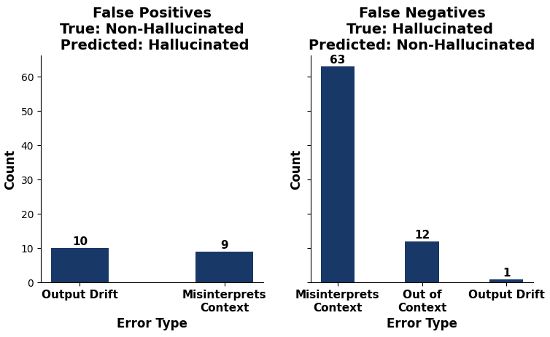
General
False Positives
True: Non-Hallucinated
Predicted: Hallucinated
False Negatives
True: Hallucinated
Predicted: Non-Hallucinated

Slide 29
Results: QA
Experiments |  |  | F1 | Recall | Precision
Baseline | + | Plaintext | 0.88 | 0.88 | 0.88
 | + | JSON | 0.88 | 0.88 | 0.89
 | + | JSON and Knowledge-Augmented Input | 0.86 | 0.86 | 0.86
 | + | JSON, Knowledge-Augmented Input and Definition-Enhanced Prompting | 0.89 | 0.89 | 0.89
 | + | JSON, Knowledge-Augmented Input, Definition-Enhanced Prompting and Step-by-Step Reasoning Rules | 0.88 | 0.88 | 0.88
 | + | JSON, Knowledge-Augmented Input, Definition-Enhanced Prompting, Step-by-Step Reasoning Rules and Hallucination Pattern Integration | 0.89 | 0.89 | 0.89
Comprehensive all-strategy prompt achieved highest F1 of 0.89
Notes:
Qwen model performed very well on Q and A task, prompt engineering actually doesn't work well here, you can see there is basically no improvements for different prompt strategies, the best prompt just improves 1% on the F1 score.

Slide 30
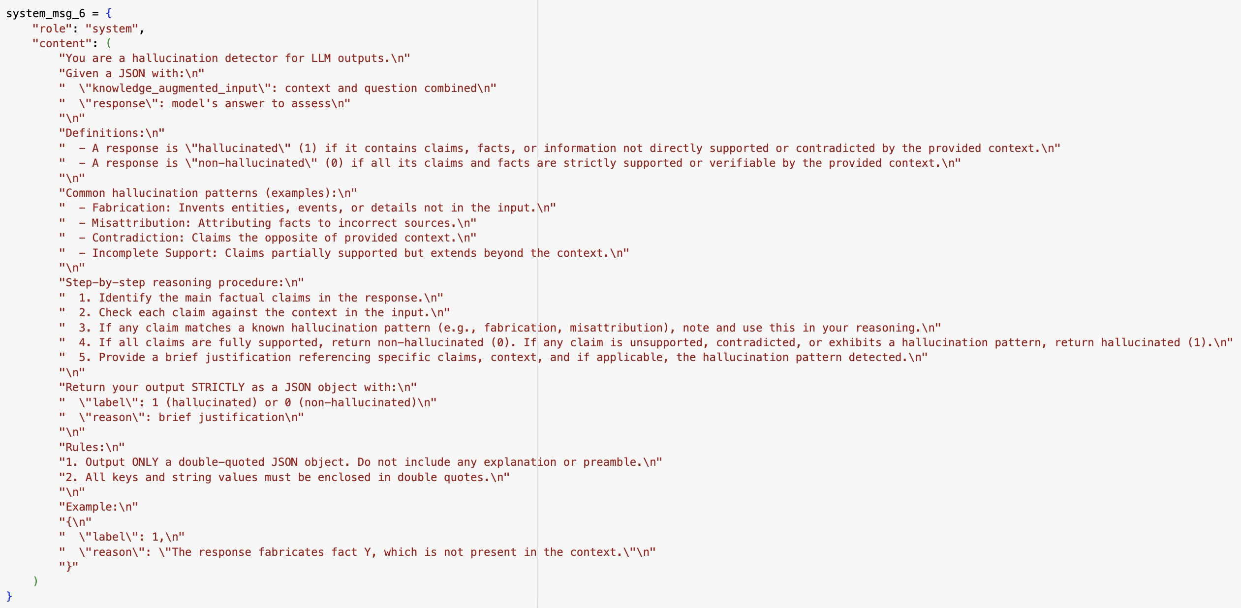
Best LLM Prompt: QA
JSON Input
Hallucination Patterns
Step-by-Step Thinking
Notes:
This is the best prompt, I use JSON input and clarify hallucination patterns, also let Qwen to think step by step.

Slide 31
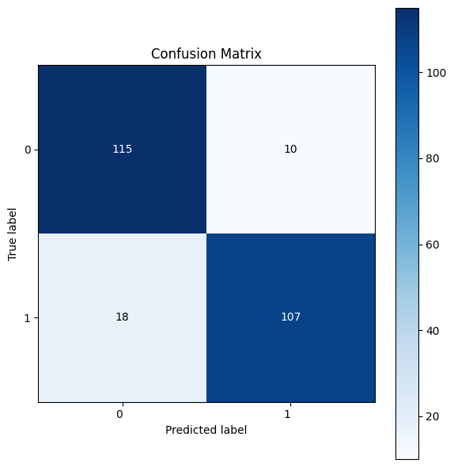
Error Analysis: QA
Error Patterns:
Context Fusion
Pronoun Confusion
Object Mismatch
The detector may be too strict, overlooking correct answers due to reasoning or wording differences, or too loose, allowing answers that aren’t supported by the context.
Possible Mitigation: Design prompts to encourage more explicit reasoning steps, making the detector to match answers with supporting context
Notes:
I checked the error labels, there are basically three patterns. First is context fusion, Qwen will misunderstand the context in the knowledge when asking questions. Second is pronoun confusion, it appears when there is more than one pronoun in the context. Third is Object mismatch, Qwen may mixed up different object.
Sometimes the detector is too strict, sometimes it's too loose, possible mitigation is to let the model more reasoning steps.

Slide 32
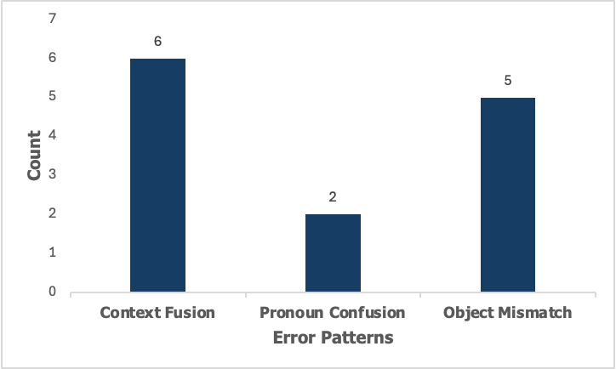
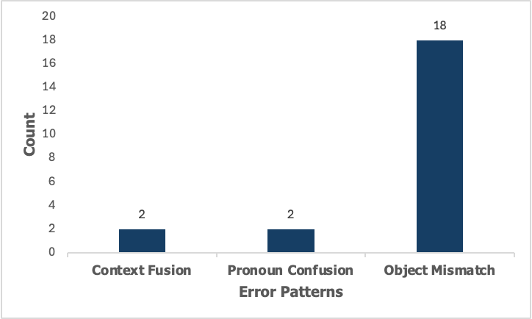
False Positives
True: Non-Hallucinated
Predicted: Hallucinated
False Negatives
True: Hallucinated
Predicted: Non-Hallucinated

Slide 33
Example of Misclassification: QA
True Label: Hallucinated
Predicted Label: Non-Hallucinated
Error Pattern: Object Mismatch
Knowledge
The Black Candle is a documentary film about Kwanzaa directed by M. K. Asante and narrated by Maya Angelou. It was created by Maulana Karenga and was first celebrated in 1966–67.
Question
The Black Candle is a documentary film about a celebration created by who?
Response
The Black Candle is a documentary film about a holiday that was created by an African American activist.
Qwen’s Reasoning
The response accurately identifies Maulana Karenga as the creator of Kwanzaa, an African American activist, which is directly supported by the context.
Notes:
Here is an example of context fusion: the response does not answer the name of the film creator's name, just says it's created by an African American activist, which is a hallucination, but Qwen thinks the answer is correct.

Slide 34
Conclusion
Tasks | Dialogue | QA | Summarization | General
Best Prompt Combination | JSON, Reasoning, Definition, Knowledge, Hallucination Pattern and Paired Response | JSON, Knowledge, Definition, Reasoning and Hallucination Pattern | JSON, Reasoning, Definition, Hallucination Pattern and Paired Response | JSON, Definition, Reasoning
F1 | 0.88 | 0.89 | 0.95 | 0.60
Accuracy | 0.88 | 0.89 | 0.90 | 0.62
Accuracy HaluEval ChatGPT (gpt-3.5-turbo) | 0.74 | 0.77 | 0.61 | 0.86
Possible Mitigation Strategies | Pre-load LLM with required domain knowledge | Prompts for more reasoning steps | Revise few-shot examples to avoid misleading cues. | Pre-load or provide LLM with more accurate and broad domain knowledge; Use more specific prompts and types of common hallucination patterns
Notes:
This is our overall conclusion, you can see the prompt strategies helped us to achieve better performance than literature paper.
For possible mitigation strategies, we can pre load LLM with domain knowledge for dialogue and general tasks, and give more reasoning steps for QA task and revise few-shot examples for Summarization task.
This is our presentation. Thank you!

Slide 35
Thank You!

